Slide 1
Photomicrographs of Plant Seeds
Flax
Permission to reproduce original photomicrographs used to make this collection may be obtained from
Dr. David O. Norris at
david.norris@colorado.edu

Slide 2
10X
Flax seed
Notes:
S28. Flax (Linum usitatissimum L.) seed (golden)

Slide 3
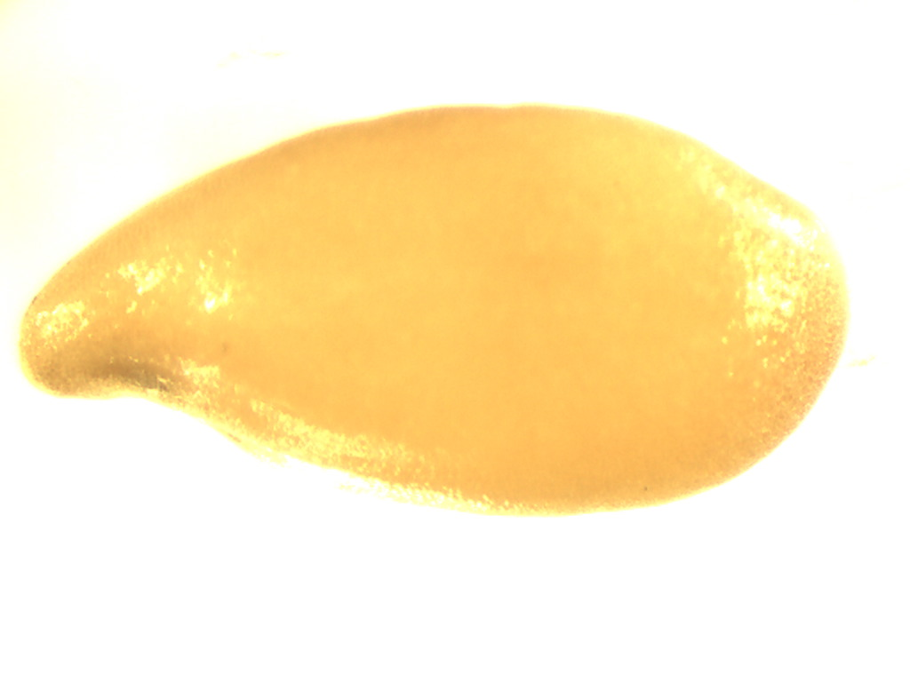
16X
Flax seed
Notes:
S29. Flax (Linum usitatissimum L.) seed (golden)

Slide 4
Flax seed
Notes:
S30. Flax (Linum usitatissimum L.) seed (golden) SEM. SEM prepared by Dr. Patrick Kociolek and Joshua Stepanek.

